Slide 1
Pointers

Slide 2
Contents
Concept
Pointer variables
Accessing variables through pointers
Pointer declaration and definition
Initialization of pointer variables
Pointers and functions
Pointers to pointers

Slide 3
Pointers - Concepts
Every computer has addressable memory locations
Data Manipulation
1) Indirect Approach: Identifiers
We use memory location addresses symbolically
  We assign identifiers to data and then manipulate their contents through the identifiers
2) Direct Approach: Pointers
Uses data addresses directly as well with ease and flexibility of symbolic names

Slide 4
Pointers
A pointer is a derived data type : a data type built from one of the standard types
Its value is any of the addresses available in the computer for storing and accessing data

Slide 5
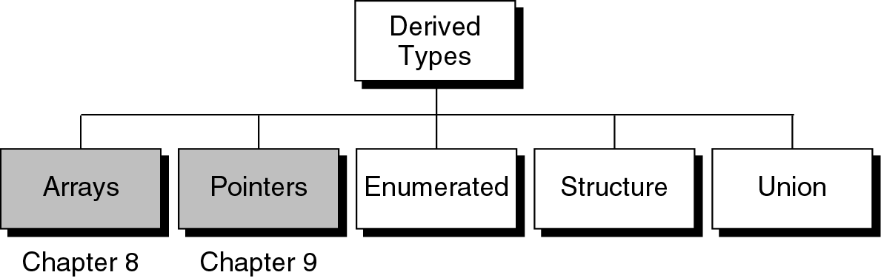
Figure 12-1
Note: Figure number x.y refers to Chapter number x and figure number y.

Slide 6
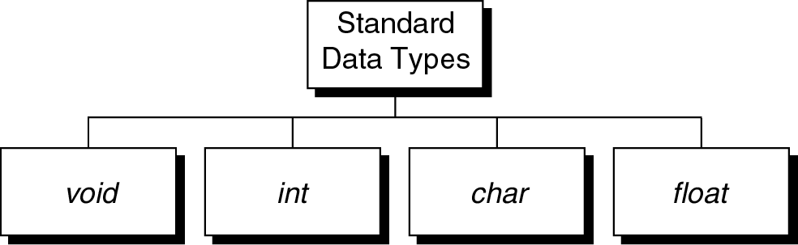
Figure 2-6

Slide 7
Pointer Constants
To understand pointers, we begin with pointer constants
First, compare character constants and pointer constants
Character constant – we can have character constants from a universe of all characters
  For most computers, it is known as ASCII
A character constant can become a value and can be stored in a variable
char aChar = ‘G’;

Slide 8
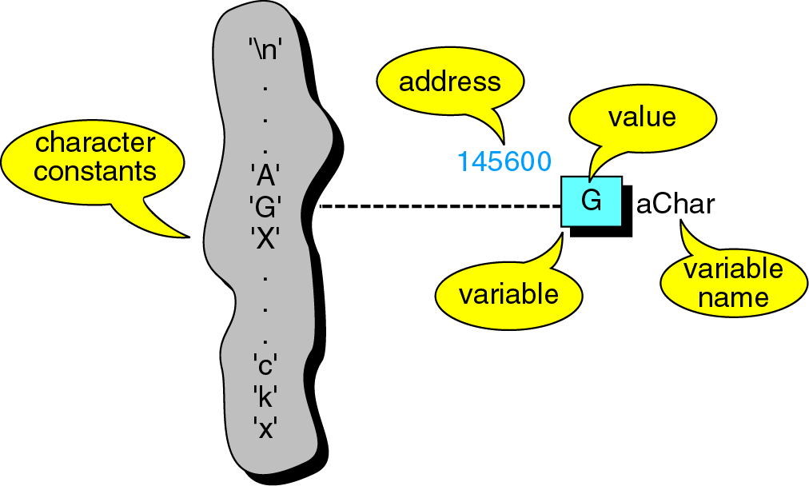
Figure 9-1 Character Constants and variables
The variable aChar has an address as well as name
The name is created by the programmer
The address is the relative location of the variable with respect to the program’s memory space

Slide 9
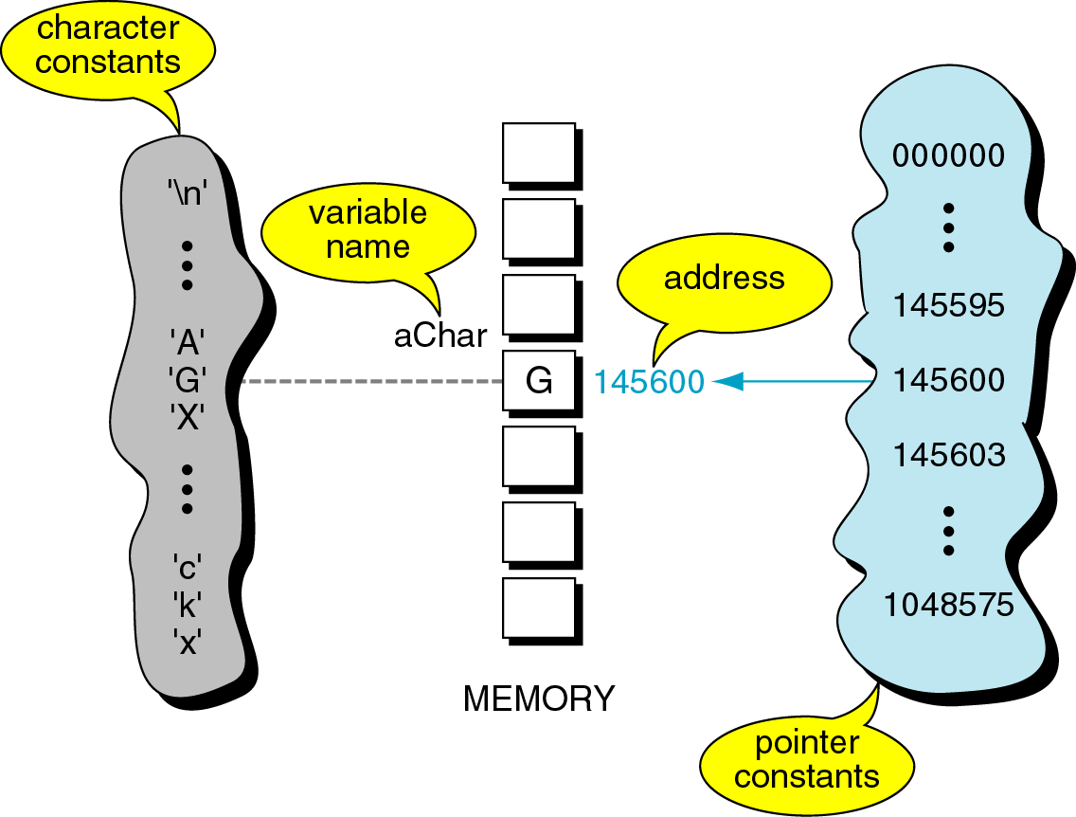
Figure 9-2 Pointer Constants
Assume that our computer has only 1MB of memory (2²⁰ bytes)
Assume that computer has chosen the memory location 145600 as the byte to store this variable

Slide 10
Character Constants and Pointer Constants
Like character constants, pointer constants cannot be changed
The address for variable aChar is drawn from the set of pointer constants for our computer
Although addresses within a computer cannot change (remains constant for the duration of the run)
  but the address of a variable will change for each run of the program
  Thus it is necessary to refer pointer variables symbolically
  NOTE: OS puts a program into memory

Slide 11
Pointer values

Slide 12
Pointer Constants
Pointer constants
an address in memory
Drawn from the set of addresses for a computer
Exist by themselves
Cannot change them; only use them
How to save this address?
We have already done it by scanf with address operator &
WAP to print addresses as pointers

Slide 13
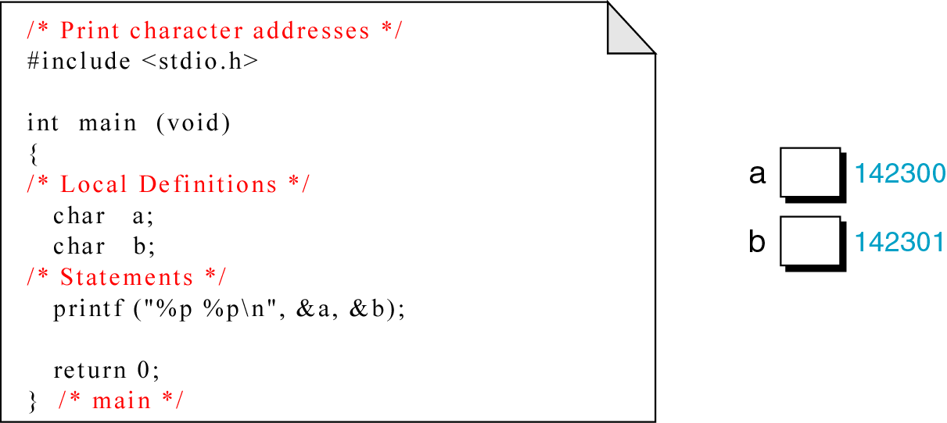
Figure 9-3
Depending on the OS, this program may print different numbers in each run
Compilers display addresses as integers or as hexadecimal numbers

Slide 14
Integer Constants and variables
In most computers integers occupy either 2 or 4 bytes
Assume we are working on a system with 4-byte integers
This means that each integer occupies 4 memory locations
Which one is then used to find the address of the variable?
  The address of a variable is the address of the first byte occupied by that variable
  For characters, there is only one byte, so its location is the address
  For integers, the address is the first byte of 4

Slide 15
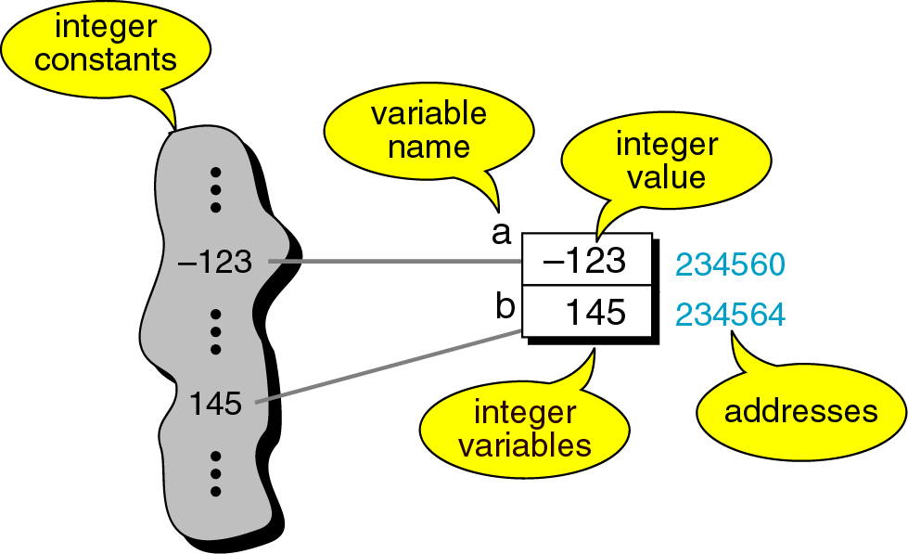
Figure 9-4 Integer constants and Variables
The address of a variable is the address of the first byte occupied by that variable

Slide 16
Pointer variables

Slide 17
Pointer variables
we have a pointer constant and a pointer value
So, we can have a pointer variable
To store the address of a variable into another variable which is called a pointer variable

Slide 18
Pointer variables
Distinguish between a pointer variable and its value
There is an integer variable whose name and location are constant, the value may change as the program executes
There is also a pointer which has a name and a location, both of which are constants

Slide 19
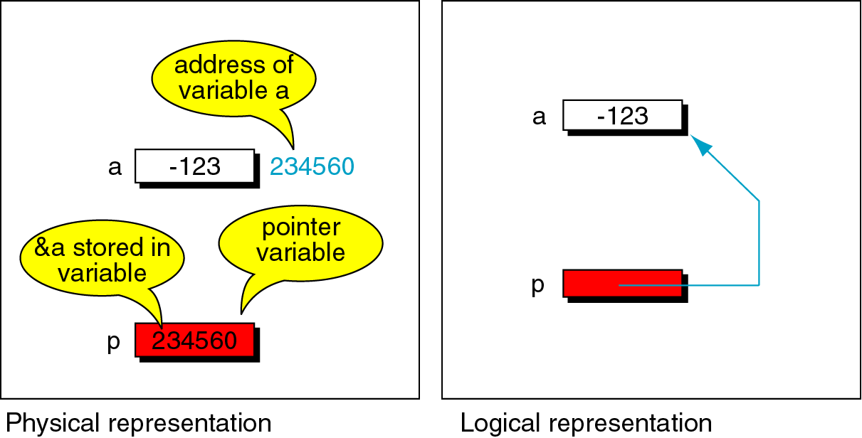
Figure 9-5 Pointer Variables
Distinguish between a pointer variable and its value
There is integer variable a with value -123
A is at location 234560 in memory
Physical representation shows how the data and pointer variables exist in memory
There is a pointer variable P with value 234560
This means that p is pointing to a
The logical representation shows the relationship between them without the physical details

Slide 20
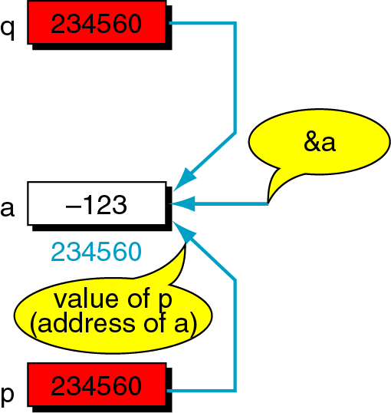
Figure 9-6 Multiple pointers to a variable
We can store a variable’s address in multiple pointer variables
There is a variable a and two pointer variables p and q
Their name and location are constant, value at this point is 234560
Both p and q are pointing to a
There can be any number of pointer variables that can point to a variable

Slide 21
Pointer variables
What if we have a pointer variable, but not want to point to anywhere?
What is its value then?
C provides a special null pointer constant NULL defined in standard input-output <stdio.h> library

Slide 22
Accessing variables through pointers

Slide 23
The indirection operator *
We have a variable and a pointer to the variable
How can we use the pointer?
C has indirection operator *
When we dereference a pointer, we are using its value to reference (address) another variable
The indirection operator is a unary operator whose operand must be a pointer value
To access the variable a through the pointer p, we write *p

Slide 24
The indirection operator
Add 1 to variable a using pointers and other means
a++; a= a+1; *p = *p + 1; (*p)++;
Any one of this statement will do it , assuming that the pointer p is properly initialized as p = &a;
(*p)++ need parenthesis because ++ has more priority than *
The parenthesis force dereference to occur and then addition
Without parenthesis, we add to the pointer first, which would change the address

Slide 25
The indirection operator *
Assume that the variable x is pointed to by 2 pointers p and q
So x, *p, *q – allow the variable to inspect when used in RHS of the assignment operator
When used in RHS, they change the value of x

Slide 26
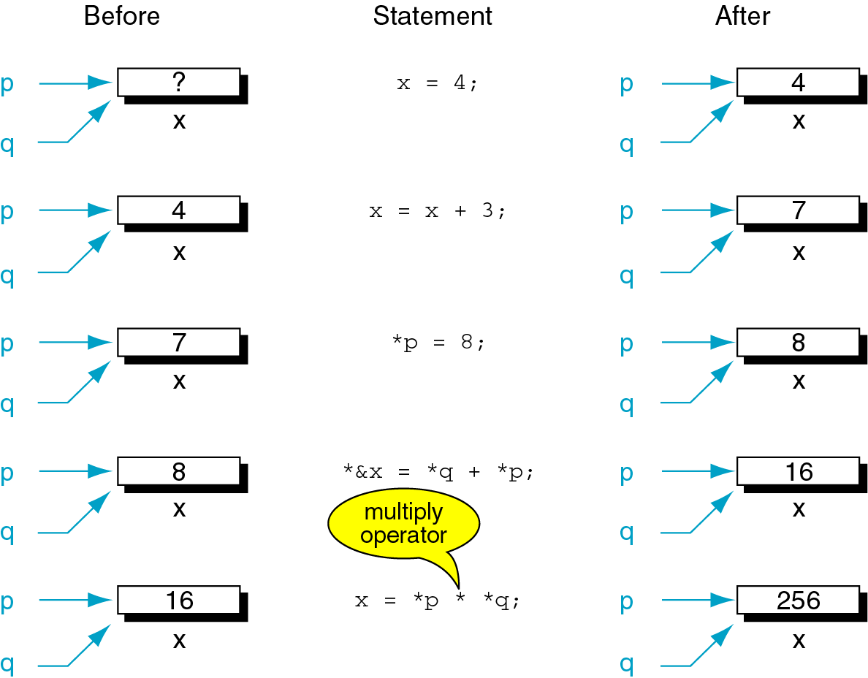
Figure 9-7

Slide 27

Figure 9-8 Address and Indirection operators
The indirection and address operators are the inverse of each other
*&x; What does it do ? (Just for illustration and not for coding)
Both are evaluated from R to L
Thus &x is done first which is a pointer value
Next, * (&x) is done which dereferences the pointer constant giving the variable x
Thus operators cancel each other

Slide 28
Pointer declaration and definition

Slide 29
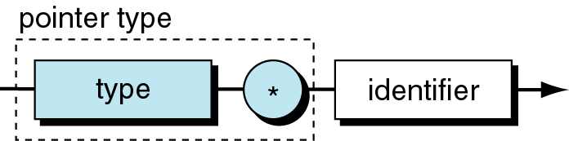
Figure 9-9
Syntax of pointer variable

Slide 30
Problem
WAP to define an integer variable a
Define a pointer to integer and assign a’s address
Print a and its address
Print the pointer value containing the address of a

Slide 31
Demonstrate pointer use
#include<stdio.h>
int main(void){
int a;
int *p;
a = 14; p = &a;
printf(“%d %p\n”, a, &a);
printf(“%p %d %d\n”, p, *p, a);
return 0;}
00135760
00135760 14 14

Slide 32
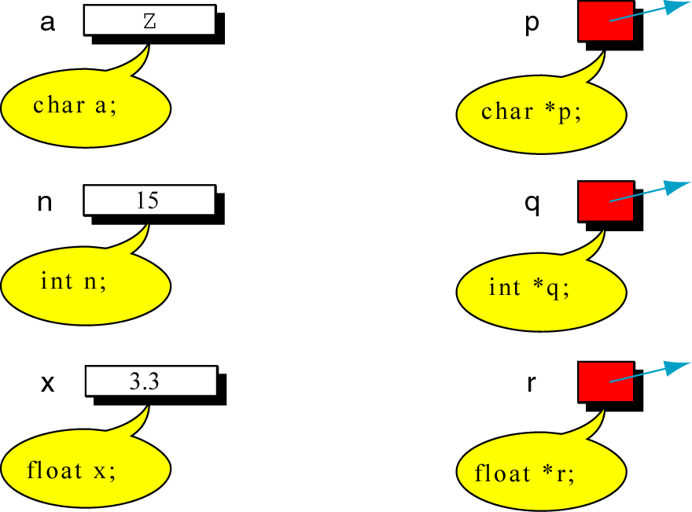
Figure 9-10 Declaring pointer variables
P is a pointer to characters, q is a pointer to integers and r is a pointer to floating point variables

Slide 33
Initialization of pointer variables

Slide 34
Initialization of pointer variables
C language does not initialize variables
  The initialization has to be done by the OS loader
  So that when we start our program uninitialized variables have garbage values
  Although OS clears memory when it loads a program cannot be considered especially with programs that runs on multiple systems

Slide 35
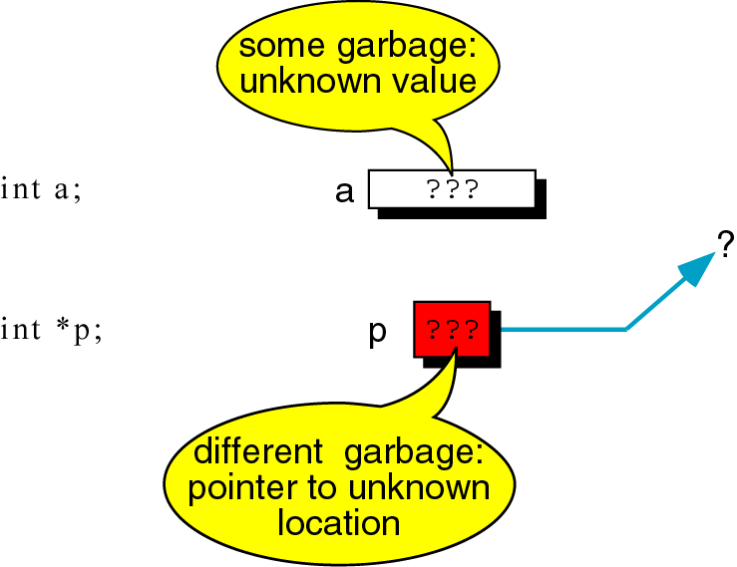
Figure 9-11 Uninitialized variables and Pointers

Slide 36
Initialization of pointer variables
Initialization of pointer variables in C language:
In the same way, C language does not initialize pointer variables
So, when the program starts, uninitialized pointer variables will have garbage address
So assign a valid memory address to the pointer
Ex:
  int a;
  int *p= &a; // p has valid address
  *p = 90; // a is assigned 90

Slide 37
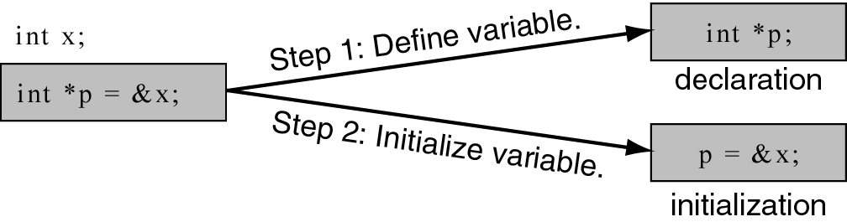
Figure 9-12 Initializing pointer variables
Syntax- Initializing pointers when they are declared and defined
Involves 2 steps
  Requires data variable be defined prior to the pointer variable
  Ex: p is a pointer to an integer, x is an integer variable
  Set p to point to x at declaration time using the syntax above

Slide 38
Initialization of pointer variables
How to set pointer to null during definition or during execution?
  int *p = NULL;
What happens when you dereference the pointer when it is null (or null pointer) ?
  When we dereference a null pointer, we are using address zero
  A valid address in the computer
  Depending on OS, this can be the physical address zero or can be the first address location in our program area
  In some systems
    A Runtime error, NULL is not a valid address

Slide 39
Initialization of pointer variables
Trace the output of the program:
Program 9.2
Declare 3 integer variables a, b, c and three pointer variables p, q and r
Make p and q point to b, r point to c
Make p point to a, q to b, c to r
Use 3 ways to sum the values - variable names, dereferenced pointer, dereferenced address operator

Slide 40
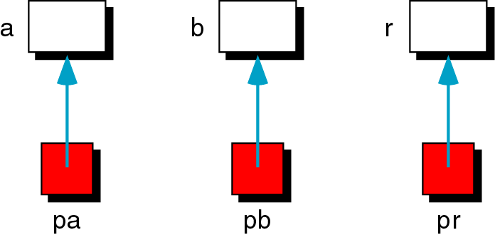
Figure 9-13 Add 2 numbers using pointers
Graphical representation of the problem is shown above

Slide 41
Add 2 numbers using pointers
Program 9.3:
Note: There is no address operator in scanf statements for pointers
This is because the pointer already contains address

Slide 42
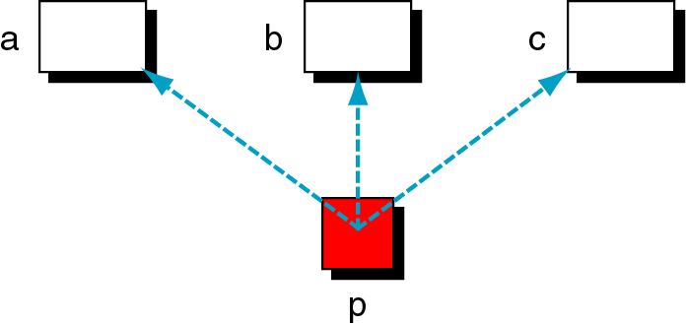
Figure 9-14 Demonstrate pointer flexibility
We can use the same pointer to point to different variables

Slide 43
Pointer Flexibility
Program 9.4

Slide 44
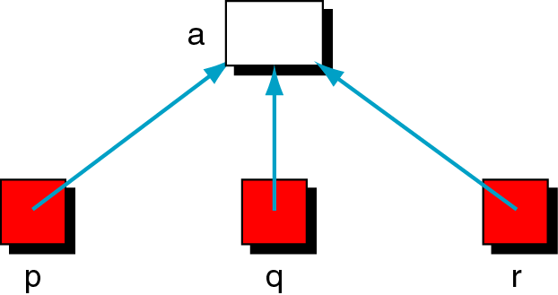
Figure 9-15 One variable with many pointers
We can use different pointers to point to the same variable in different statements

Slide 45
Pointer Flexibility
Program 9.5

Slide 46
Pointers and Functions

Slide 47
Pointers and Functions
Functions receiving pointer values as arguments
  Ex1: exchange program without pointers
  Ex2: exchange program with pointers
Functions returning a pointer to the calling function
  Ex: program to find the smaller of two numbers by taking address of two numbers as input and returning address of smaller number as output

Slide 48
Pointers and Functions
Most useful application of pointers is in functions
How C function operates?
  C uses pass by value concept
  This means that the only direct way to send something back from a function is through return value
How to simulate pass by address?
  We can simulate the pass by reference by passing an address and using it to refer back to data in the calling program
  When we pass by address, we are actually passing a pointer to a variable
Let us develop this concept of passing addresses or pointers to functions

Slide 49
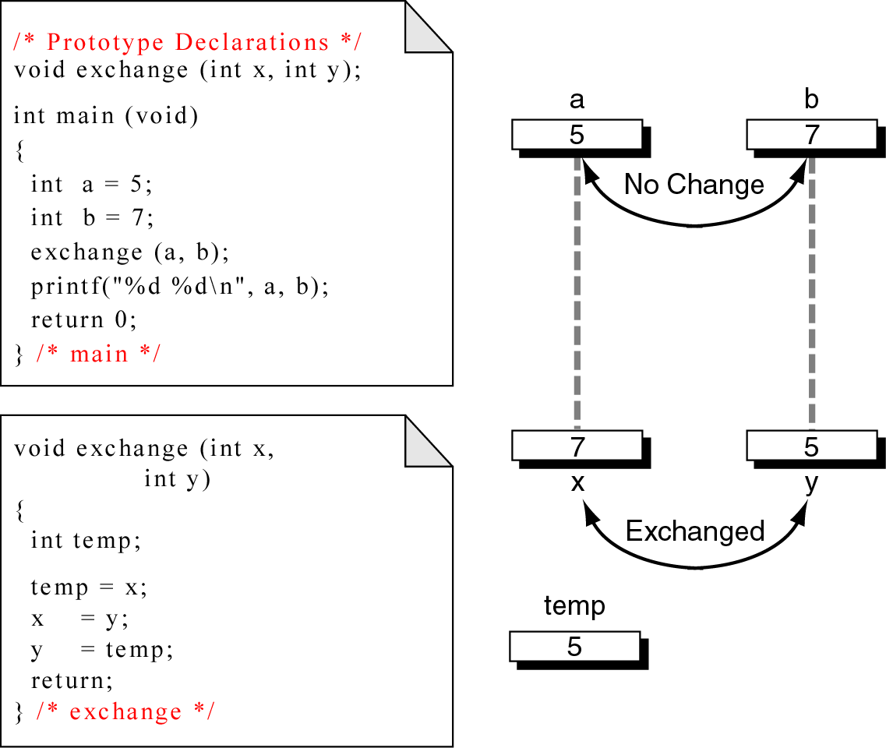
Figure 9-16 Exchange program unworkable using pass-by-value
Note: Using pass by value method, the data are exchanged in the called function but not in the calling program

Slide 50
Pointers and Functions
Now rather than passing the values of the two elements to be exchanged,
  pass the pointers to the values.
Given a pointer to a variable anywhere in our memory space
  (whether it is local to a function or main() or a global variable)
  we can exchange the content of the variable

Slide 51
Pointers and Functions
It is important to understand that C still uses pass by value
  Now the value is the address of the variable we need to change
  We are only simulating pass by reference

Slide 52
Pointers and Functions
If we want a called function to have access to a variable in the calling function send the address of that variable to the called function and use the indirection operator & to access it
To send back more than one value from a function, use pointers
By passing the address of variables defined in calling function, we can store data directly in the calling function rather than using return

Slide 53
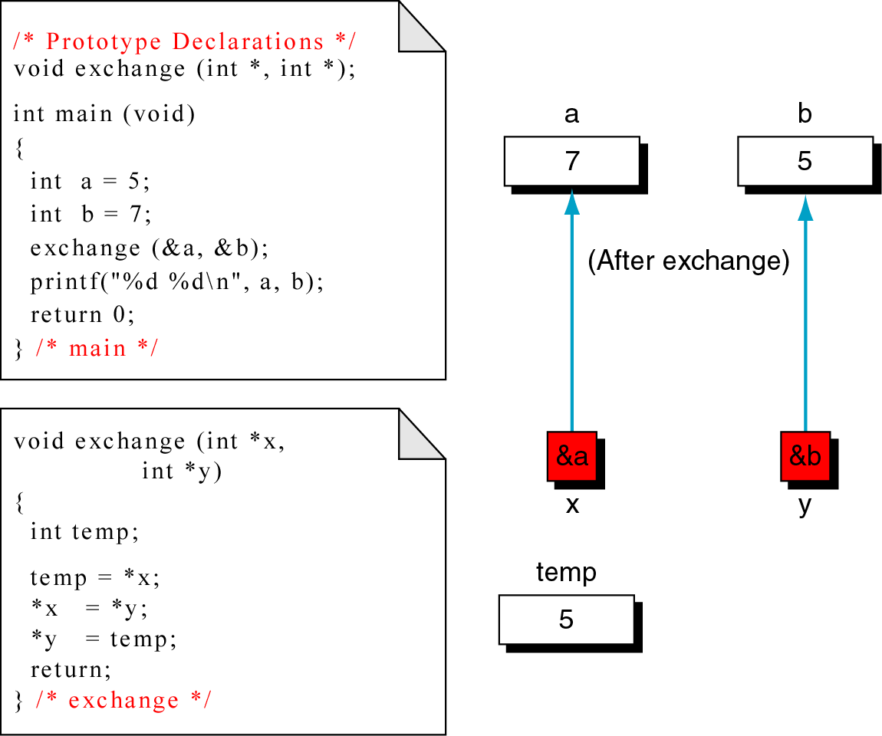
Figure 9-7 Exchange using pointers

Slide 54
Functions Returning Pointers

Slide 55
Functions Returning Pointers
So far, functions used pointers but none returned a pointer to the calling function
Program:
Determine the smaller of 2 numbers
Need a pointer to the smaller of 2 variables a and b
Since we are looking for a pointer, we pass 2 pointers to the function which uses a conditional expression to determine the smaller value
Next, return the address of its location as a pointer
The return value is then placed in the calling functions pointer, p so that after the call it points to either a or b based on their values

Slide 56
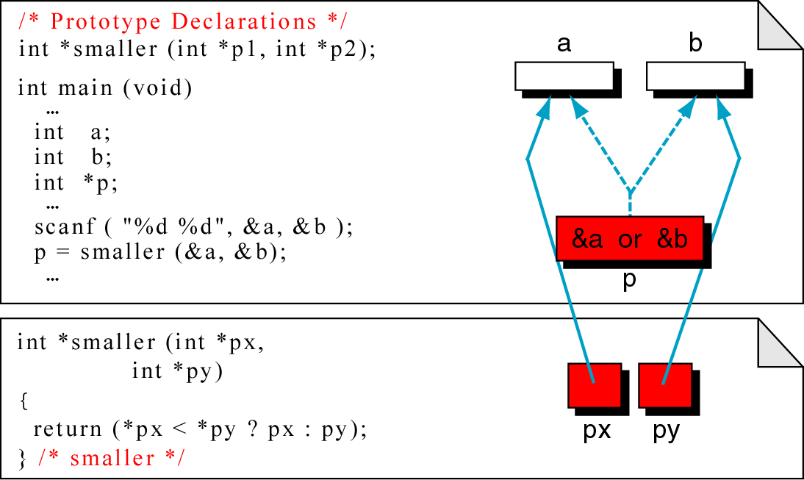
Figure 9-18 Functions Returning Pointers

Slide 57
Functions Returning Pointers – Points to note
It is a serious error to return a pointer to a local variable
When we return a pointer, it must point to data in the calling function or a higher level function
It is an error to return a pointer to a local variable in the called function because
  When the function terminates, its memory may be used by other parts of the program
  Especially evident in large programs

Slide 58
Pointers to Pointers

Slide 59
Pointers to Pointers
So far:
All pointers have been pointing directly to data
Advanced data structures require
Pointers that point to other pointers
Ex: we can have a pointer pointing to a pointer to an integer
This two-level indirection is shown next
Note: Although many levels of indirection can be used but practically not more than two levels are needed

Slide 60
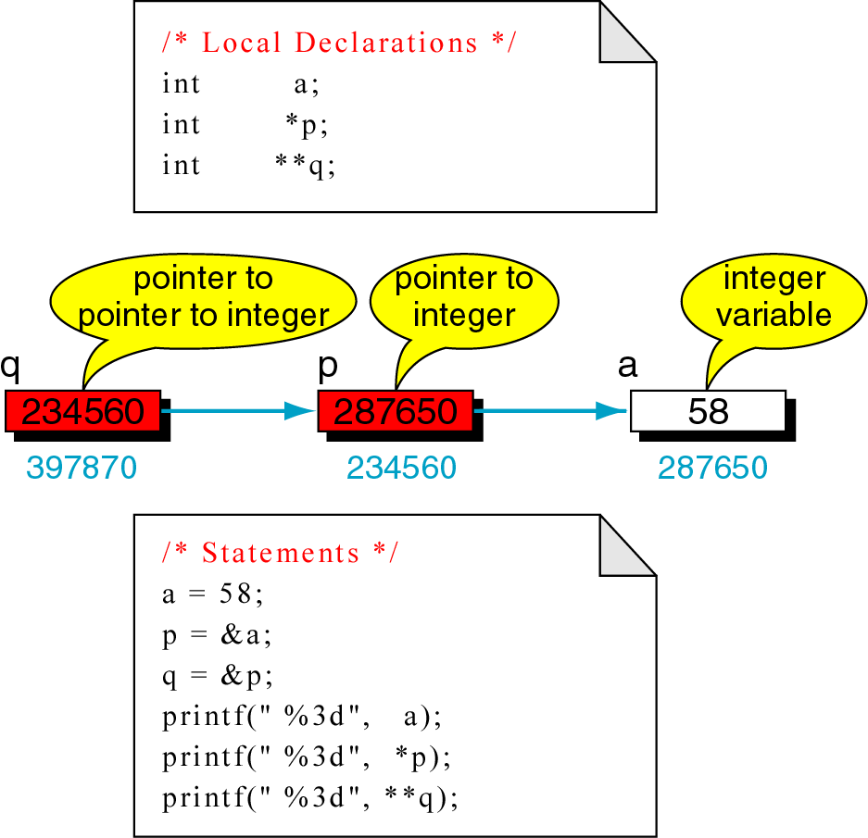
Figure 9-19 Pointers to pointers

Slide 61
Pointers to Pointers
Syntax:
Each level of pointer indirection requires a separate indirection operator when it is dereferenced
Ex: To refer to a using the pointer p, we have to dereference it once as
*p
To refer to a using the pointer q, we need to dereference it twice to get to the integer a as there are 2 levels of indirection (pointers) involved
By first dereference we reference p, which is a pointer to an integer

Slide 62
Pointers to Pointers
Syntax:
q is a pointer to a pointer to an integer
**q
Program:
WAP to print the value of a by 4 means:
  Directly using a
  Using pointer p
  Using pointer q
  Using pointer r

Slide 63
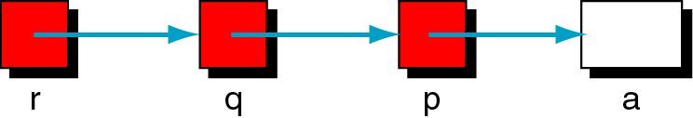
Figure 9-20 Using pointers to Pointers – A graphical representation

Slide 64
Pointers to Pointers
int a ;
int *p;
int **q;
int ***r;
p = &a; q = &p; r = &q;
printf(“enter a number”);
scanf(“%d”, &a);
printf(“the number %d\n”, a);
printf(“enter a number”);
scanf(“%d”, p);
printf(“the number %d\n”, a);

Slide 65
Pointers to Pointers – contd…
int a ;
int *p;
int **q;
int ***r;
p = &a; q = &p; r = &q;
printf(“enter a number”);
scanf(“%d”, *q);
printf(“the number %d\n”, a);
printf(“enter a number”);
scanf(“%d”, **r);
printf(“the number %d\n”, a);

Slide 66
End

